Slide 1
Integration of statistical registers as a way to increase NSI responsiveness to users and policy needs
Ninth Meeting of the United Nations Network of Economic Statisticians
Virtual, 7:00 am - 8:30 am, November 12, 2025, New York time
Stefano Menghinello
Department for Economic and Environmental Statistics, National Accounts
ISTAT
ITALY
Notes:
This session will provide an overview of the decisions of the UN Statistical Commission in March 2023 and the follow up work of the UNCEBTS. This session also introduces the objectives of the meeting and review the UNCEBTS mandate.

Slide 2
Outline of the presentation
The traditional role of business register in NSI
The strategy developed by UNCEBTS
How BR can address key topics from media and policy makers: some business cases
  How are demographic decline and population aging impacting the survival and innovation capacity of businesses? labour hoarding, aging and human capital inside the firm
  How do environmental risks impact businesses, particularly SMEs? environmental vulnerability
  Are exporting companies environmentally sustainable? Export, productivity, sustainability

Slide 3


The traditional role of business register in NSI
BR represents a unique asset for NSIs which guarantees the coherence of statistical information but which requires high financial and human resource investments
Current use:
Data infrastructure to identify target population and economic classification
Methodological framework for sampling and grossing up of direct survey and administrative data integration
Possible development:
Enriched BR as an input for National Accounts
Integrated BR for policy evaluation
Integrated BR for user needs

Slide 4
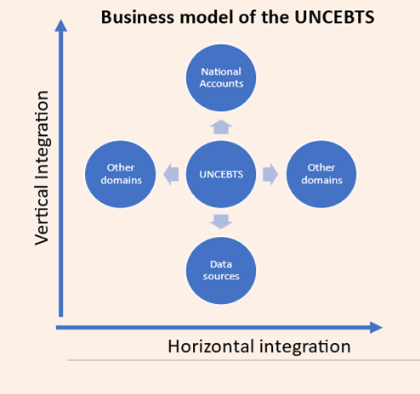
The strategy developed by UNCEBTS
UNCEBTS had developed an enterprise-centered approach rooted in BR
BR usability can be assessed based on a maturity model
The verticial dimension underlines, downstream, the importance of integration with basic sources (surveys, administrative data and new information sources) but also, upstream, with broader statistical frameworks (national accounts and environmental accounts)
The horizontal dimension emphasizes the integration of business registers not only within the business domain but also with other social and environmental domains.

Slide 5
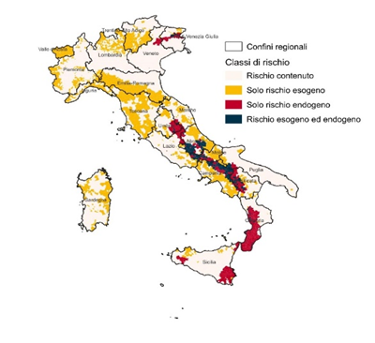
Mapping companies located in areas with environment risks
Analysis presented by ISTAT in its Annual Report on the State of the Nation with a big impact on Media.
Methodology: link between business register of local units integrated with SBS data with the map of environmental risks
Unit of analysis: municipality (there are a little bit less than 8.000 municipalities in Italy)
18% of value added of resident businesses is located in municipalities with at least a serious environmental risk.
The National Civil Protection Agency has already requested these data at the sub-municipal level
Limited risk
landslide events only
seismic events only
both risks

Slide 6
Aging inside companies in Italy
Analysis presented by ISTAT in its Annual Report on the State of the Nation with a big impact on Media.
Methodology: link between the BR, the register on employers-employees and data on education
Unit of analysis: business enterprises resident in Italy
Indicator: demographic vulnerability measured as the ratio of senior (55+) to junior (25 or less) employees at the firm level
Main evidence: high level of risk in traditional service sector (lawyers, etc) and SMEs, large and medium side enterprise have an average a younger workforce. The aging of the workforce within companies can be however offset by increases in human capital in relation to the higher level of education of young people. Micro-based empirical evidence is found on the relationship between companies' innovative capacity in digitalisation and the entry of a young workforce with digital skills

Slide 7
Exporting companies and environmental sustainability
New data included in the Statistical Yearbook on foreign trade produced by ISTAT and ICE.
Methodology: link between the BR, trade operators register and external database with certified companies for environmental sustainability
Unit of analysis: exporting enterprises resident in Italy
Main evidence: Distribution of environmentally sustainable exporting enterprises by side and industry. Positive effect of environmental engagement on firm productivity with policy implications on transitions.

Slide 8
Conclusion
BR represents a unique data infrastructure set up and maintained by NSI as the main tool, beyond definitions and classifications, to maintain a high degree of consistency within official statistics
However, the BR represents a very high cost for NSIs which should be accounted for with respect to its actual relevance.
The value of BR is largely underestimated inside NSI and unknown outside NSI
The framework developed by UNCEBTS can contribute to better leverage the value of BR
The business cases presented by ISTAT can be can be expanded to consider further aspects based on best practices developed by other countries

